Slide 1
REDEEMERS UNIVERSITY SIWESS DEFENSE PRESENTATION
Lessons and Experiences gained during my Industrial Training

Slide 2
STUDENT’S PROFILE
Name: Adedokun Isaac Oluwaseyi
Company Name: State Information Technology Agency(SITA)
Matriculation Number: RUN/CMP/21/10951
Department: Computer Science
Academic Session: 2023/2024

Slide 3
ORGANOGRAM OF SITA
CHAIRMAN
PERMANENT SECRETARY
SOFTWARE DIRECTOR
ENGINEERING DIRECTOR
PLANNING AND IT DIRECTOR
FINANCE AND ADMIN DIRECTOR
CIVIC DATA MANAGEMENT DIRECTOR
OC REGISTRY
SPECIAL DUTIES
DEPUTY DIRECTOR
DEPUTY DIRECTOR
DEPUTY DIRECTOR
DEPUTY DIRECTOR
ACCOUNTANT
ACCOUNT CLERK

Slide 4
OUTLINE
Introduction
1. Students Industrial Work Experience Scheme (SIWES)
2. State Information Technology Agency (SIWES)
Skill and Experience gained
Conclusion
Recommendation
References

Slide 5
introduction-student industrial work experience scheme (siwes)
The Student Industrial Work Experience Scheme (SIWES) is a skill training programme designed to expose and prepare students of various universities, colleges and other various tertiary institutions for industrial work situations that they’ll meet after graduating. It is a planned and structured programme based on stated and specific career objectives of the various students and is used to gear them towards developing the occupational competencies of the candidates and consequently the rationale for initiating and designing the scheme by the Industrial Training Funds ITF, in 1973.
The Industrial Training Fund (ITF) started SIWES introduction, initiation and design in 1993 to acquaint students with the skills of handling employer’s equipment and machinery.

Slide 6
INTRODUCTION-STUDENT INDUSTRIAL WORK EXPERIENCE SCHEME (SIWES)
Aim and Objectives of SIWES
To provide an avenue for students in the Nigerian universities to acquire industrial skills and experience during their course of study.
To prepare students for the work situation they are likely to meet after graduation.
To expose the students to work methods and techniques in handling equipment and machinery that may not be available in their universities.
To allow the transition phase from school to the world of working environment easier and facilitate students’ contact for later job placement.
To provide students with an opportunity to apply their theoretical knowledge in real work situation thereby bridging the gap between theory and practice.

Slide 7
INTRODUCTION-STUDENT INDUSTRIAL WORK EXPERIENCE SCHEME (SIWES)
Stakeholders involved in managing SIWES program
1. Federal Government (FG)
2. Industrial Training Fund (ITF)
3. Nigerian University Commission (NUC)
4. Institution
5. Employers
6. Students

Slide 8
INTRODUCTION-STATE INFORMATION TECHNOLOGY AGENCY (SITA)
About
The first IT unit in the State was created by the Late Chief Adebayo Adefarati and was upgraded into a full department and named as State Information Technology Development Centre (SITDEC). It was later upgraded to a full fledge Agency as Ondo State Information Technology Development Agency (ODSITDA) on 15th August 2007 by the former Governor of Ondo state, Late Dr. Olusegun Agagu. The Agency was renamed to SITA by the succeeding Administration headed by Dr. Olusegun Mimiko in 2008. Presently, SITA has been merged with Ondo State Civic Data Centre in 2017 with the bill stating her merger, being passed in 2017.
Vision: To become the leading and respected ICT State in Nigeria.
Mission: To be the engine room for policy regulation and deployment of ICT solutions for effective governance.

Slide 9
SKILL AND EXPERIENCE GAINED
1. Building friendship with people within the organization
2. Building friendship with people outside the organization
3. Leadership skills
4. Learning Management System with WordPress
5. I started learning Data Analysis and a little on Business Intelligence
6. Public speaking

Slide 10
SKILL AND EXPERIENCE GAINED
Building friendship with people withing the organization
1. During my industrial training I was able to build good friendship with the staff in which I was also able to help staffs that were in other department.
2. I was able to learn more in the various aspect of technology that my fellow SIWES colleagues were into like UI/UX, Networking, Html and CSS
3. I was also able to share what I know also to other fellow SIWES students
4. We were able to get along well together and even discuss together whenever we were given projects and work together
5. we shared responsibility among ourselves well

Slide 11
Skill and experience gained
Building friendship outside the organization
1. During the remaining 2 month of my Industrial Training the Ondo State Government made available free public transport to their civil servants in which I was able to enjoy it and made a friend in the bus
2. Outside of the office I was also able to build friendships with the people at the church I attended
3. In my little way I also made sure I was useful to God in helping the church I attended by cleaning the chairs.

Slide 12
Skill and experience gained
Leadership Skill
I was assigned the IT Coordinator during my Industrial Training which gave me the privilege of serving others, helping others and taking on responsibilities which I’ll list bellow:
1. To organize classes for all IT students
2. To ensure nothing misses in the lab and all equipment is switched off after we’re done.
3. To assign other’s to teach so everyone will be able to share what he/she knows
4. Ensure the door of the Lab is locked and the Key to the office is returned to the appropriate office
5. To make sure I have the applications we’re using so I can share it to others and see that everyone is participating

Slide 13
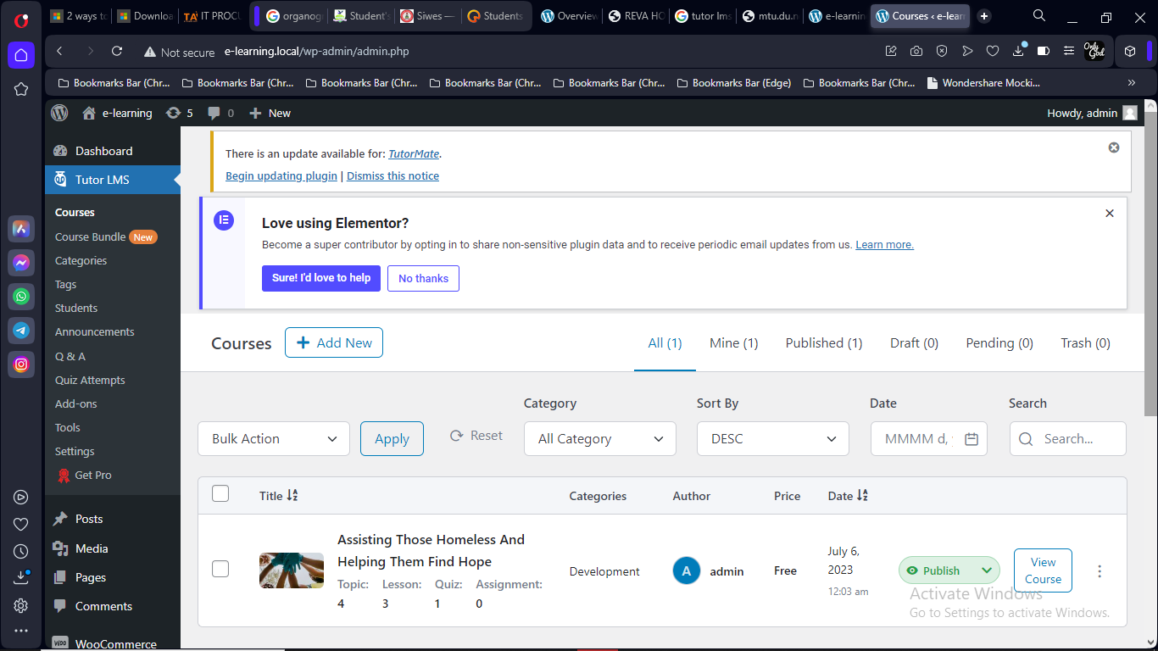
Skill and experience acquired
LEARNING MANAGEMENT SYSTEM WITH WORD-PRESS
During my Industrial Training I was able to learn more on Word-Press and it’s usefulness also about themes and plugins available
PLUGIN: is a software or an add-on that adds extra features and functionality
THEME: changes your website style and appearance
I was able to use a video example to create my own LMS Website in which I used plugins like woo-commerce to make it a site where payments can be made and you’ll have your own shop which shows you how much you’ve made and how many people are taking your course
I was also able to use Astra as my theme and if you wanted to add payment gateway plugins like PayPal can be used.

Slide 14
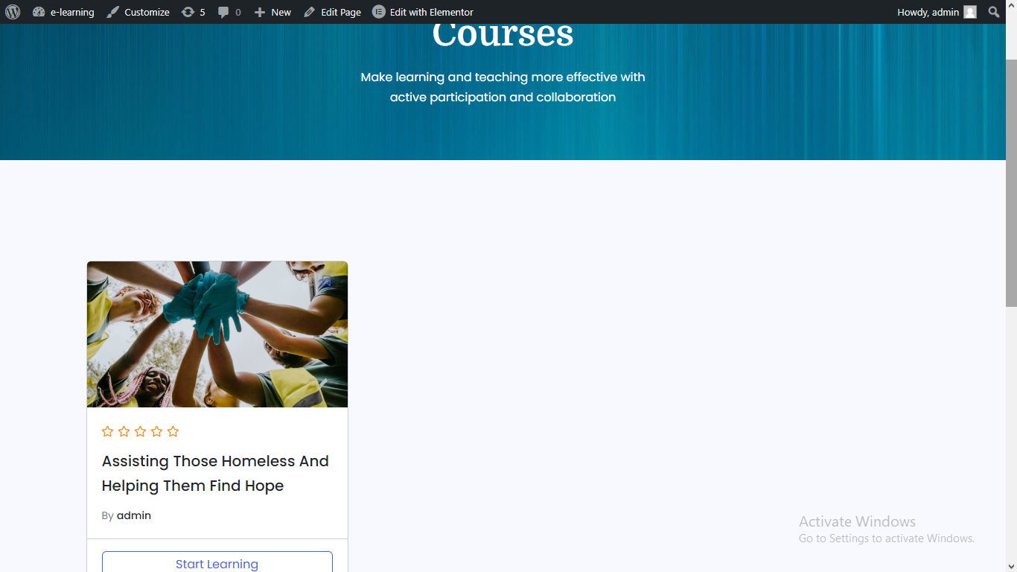
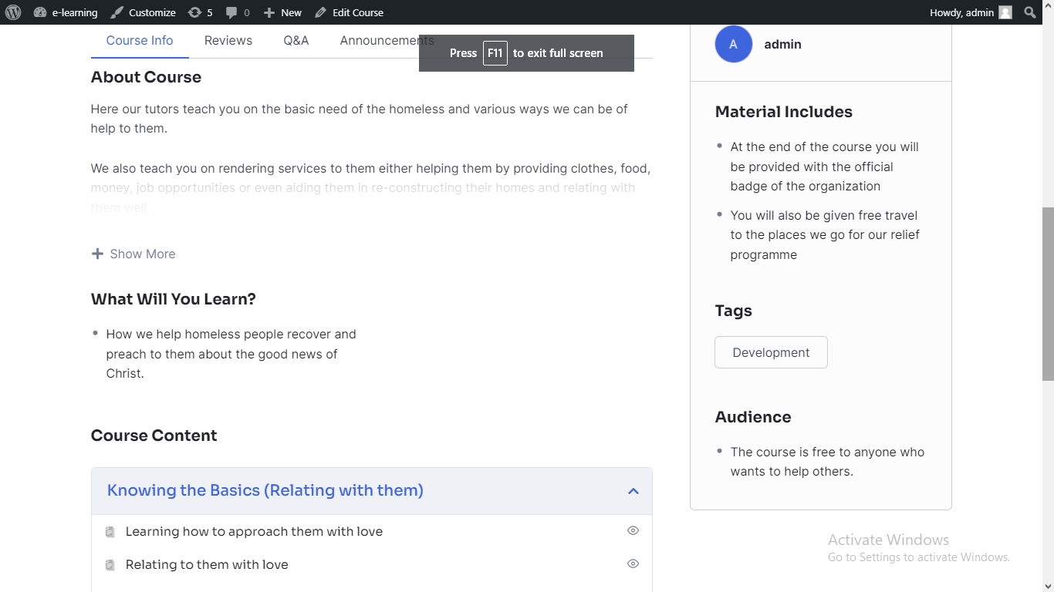
Skill and experience acquired LEARNING MANAGEMENT SYSTEM WITH WORD-PRESS

Slide 15
SKILL AND EXPERIENCE GAINED
DATA ANALYSIS AND BUSINESS INTELLIGENCE
Data Analysis is the process of converting raw data into useful information for decision makers.
Business Intelligence is the process of converting raw data into useful/actionable information for decision makers in a business situation
The reason it is called business intelligence is that it makes decisions based on the data given.
The goal of Data Analysis and Business Intelligence is to: create useful, actionable, adaptable information for decision makers in the form of reports, visualization and dashboard
BOTH DATA ANALYSIS AND BUSINESS INTELLIGNECE HELPS TO:
1. see trend and patterns
2. answer question and gain insight

Slide 16
SKILL AND EXPERIENCE GAINED
DATA ANALYSIS AND BUSINESS INTELLIGENCE
ELEMENTS OF DATA ANALYSIS
1. Data Mining
2. Data Visualization
3. Data Processing
4. Data Presentation

Slide 17
Skill and experience gained
PUBLIC SPEAKING
I was given the privilege to be able to give presentations and teach also during my Industrial Training, which enabled me learn how to speak to a crowd and build my confidence while speaking publicly.
I gave presentations on topics like Cloud Computing and Data Mining which also gave me little knowledge about this fields and the possibilities of going into either of the field of technology.
I also learnt from others and how they did their own presentation and learnt little on the topics they were given and their style of presentation.

Slide 18
conclusion
I’m very grateful to everyone involved in making this Industrial Training a success because I’ve learnt through this Industrial Training that life is more than just academics alone.
It involves building good and sound relationships with people, being kind and understanding towards others and acknowledging that you don’t know it all and you can’t do it alone and above all involving God as the center of everything in your life. And I’ve been able to realize all this thanks to the Industrial Training I did and everyone involved.

Slide 19
recommendation
The school can organize seminars to enlighten the students on the various aspect of computer science not only programming so it can give them a forehand knowledge of what area of the world they want to use computer science for.
The school can periodically check up on the students through phone calls
The issue of transportation can be sorted with the students.

Slide 20
references
About SIWES and Scope of SIWES. Retrieved November 1, 2023, from https://nou.edu.ng/students-industrial-work-experience-scheme-siwes/
Aim and Objective of SIWES. Retrieved November 1, 2023 from https://mtu.edu.ng/centers/student%27s-industrial-work-experience-scheme
State Information Technology Agency. Retrieved November 1, 2023, from https://sita.ondostate.gov.ng/service/it-procurement

Slide 21
THANK YOU!

